Slide 1
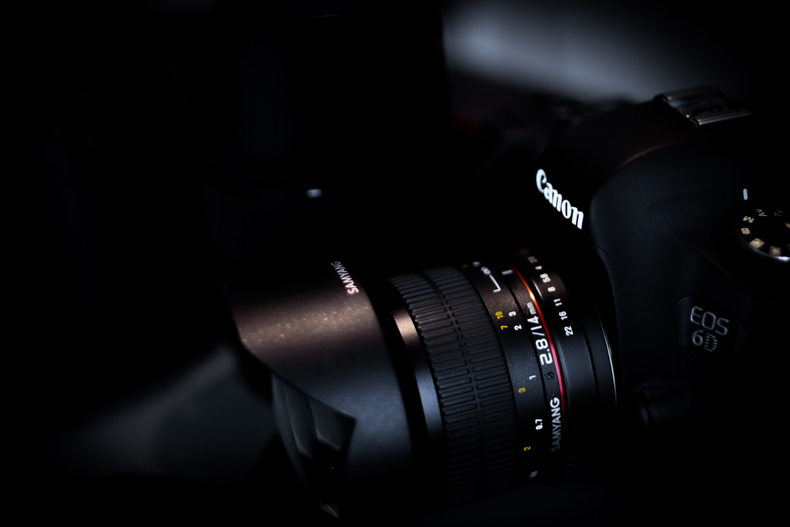

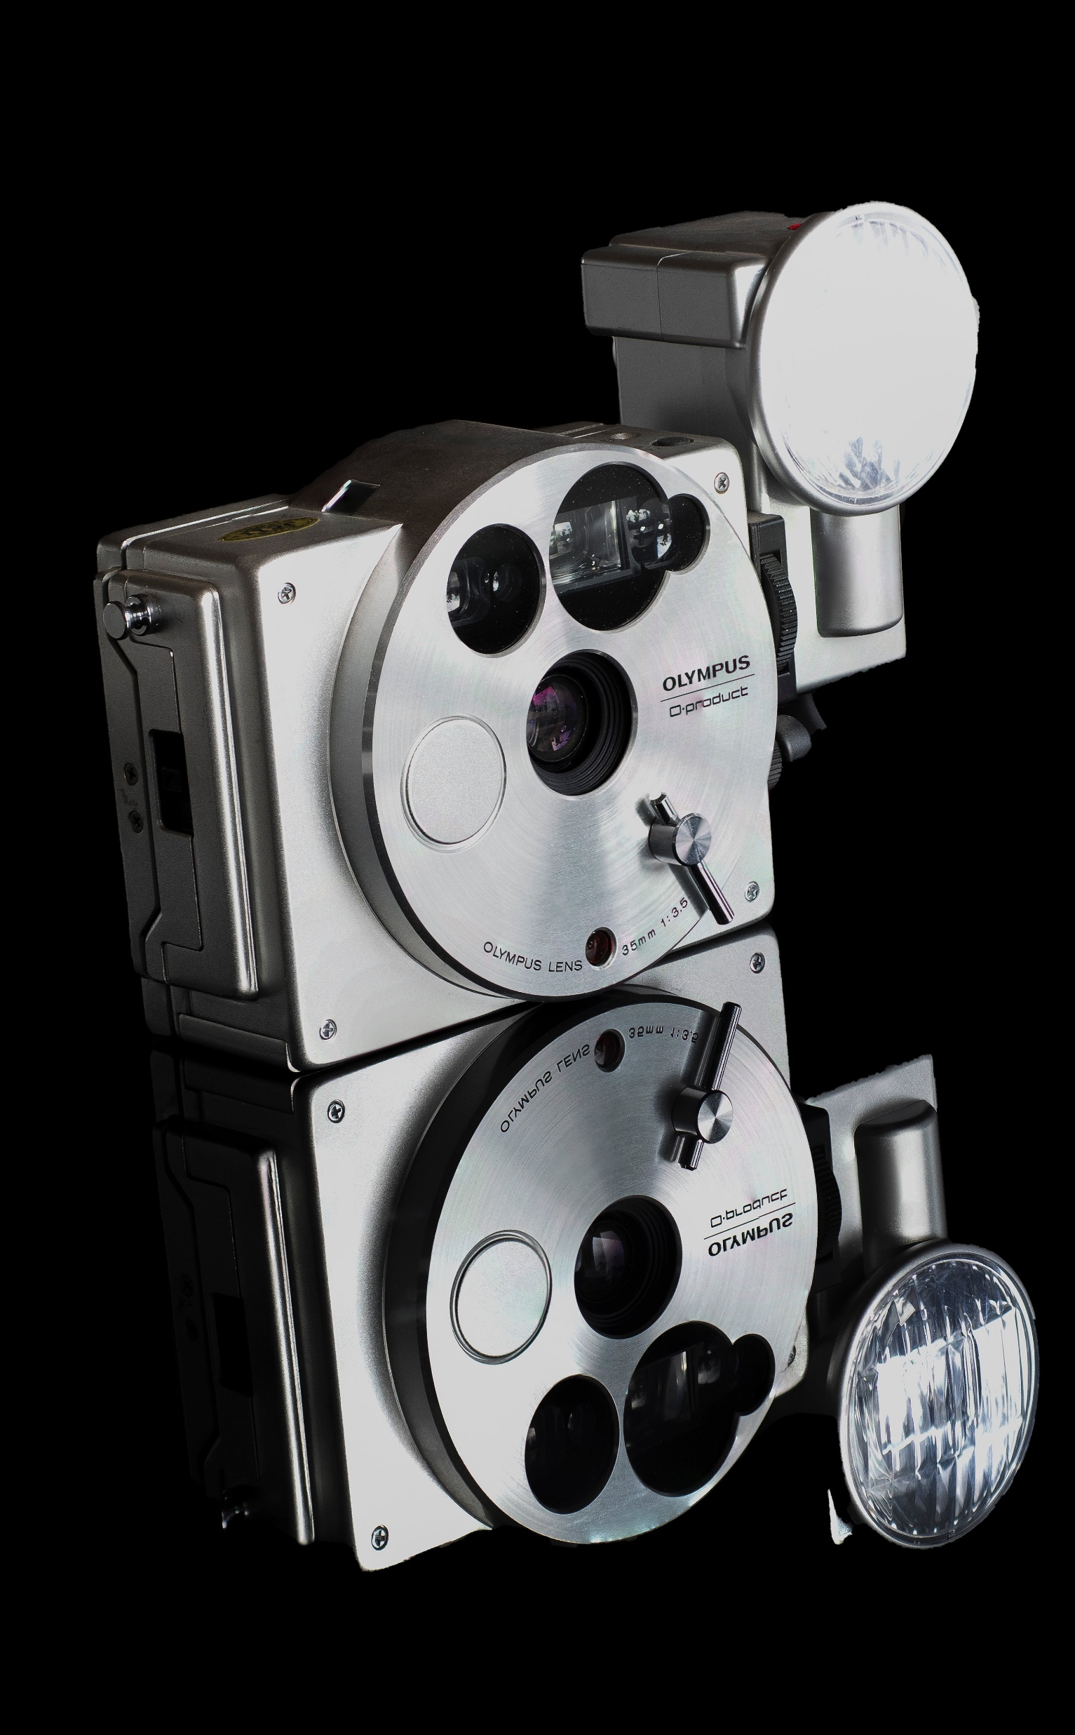
APP PHYSICS 167
APPLIED OPTICS
COLOR IMAGING
COLOR APPERANCE PHENOMENA
NINO PHILIP RAMONES | GITHUB
2020 – 05616
DECEMBER 7, 2023

Slide 2
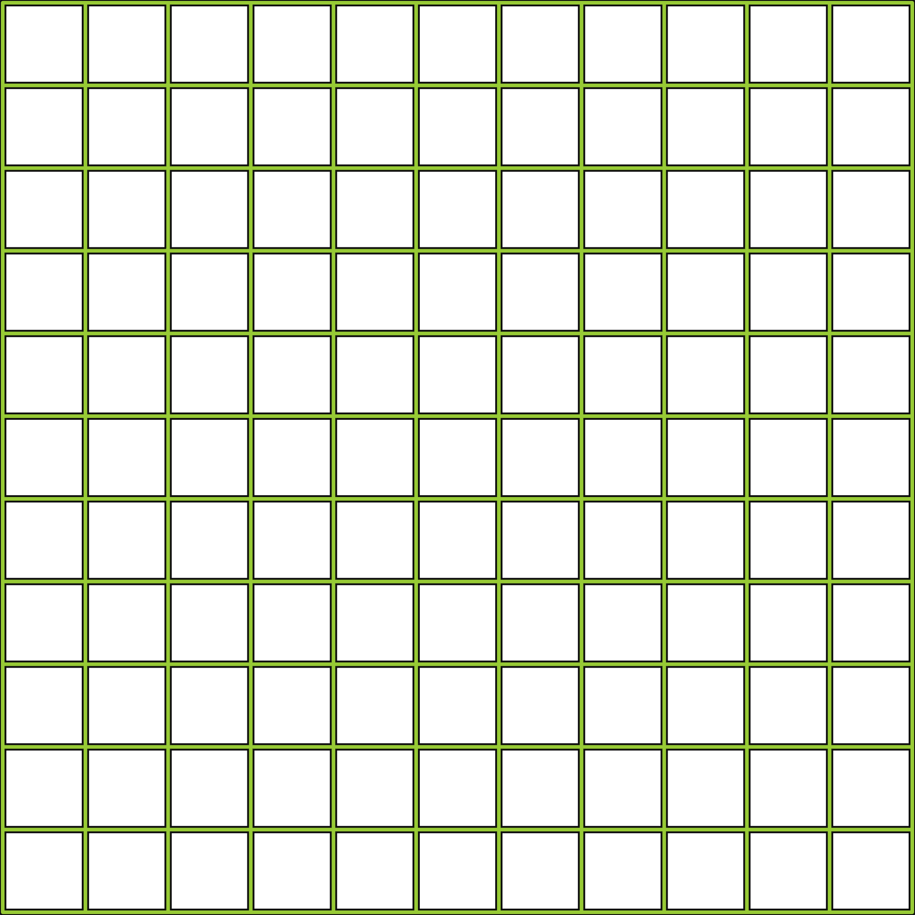
APP PHYSICS 167
FUNDAMENTALS OF MICROSCOPY
OBJECTIVES
Observe and render a color given the spectral information from a source emittance, surface reflectance, and imaging sensor sensitivity at different wavelengths across the visible spectrum
Demonstrate how color perceived changes under different illuminations
KEY TAKEAWAYS
Color information depends on the light source, the reflectance or general spectral property of the object, and the sensitivity of the imaging sensor
Observing changes in color rendering is necessary in spectral imaging of such objects crucial in image processing
SOME PITFALLS
The RGB values is convenient to scale between 0 to 1 instead of the standard 0 to 255 range as the latter yields an error in the clipping range of values in Python
Adjusting the RGB values by a constant factor could sometimes change the color being rendered and it takes some trial and error to obtain the desired color

Slide 3




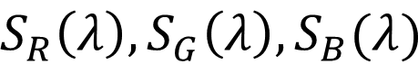
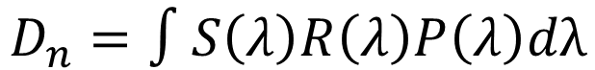

APP PHYSICS 167
COLOR IMAGING
TRINITY OF COLOR
Figure 1. Color trinity diagram that represents how color rendered is dependent on three parameters --- spectral sensitivity, object reflectance, and spectral power of light source
Object reflectance
$$P(λ)$$
$$S_{R}\left(λ\right), S_{G}\left(λ\right), S_{B}(λ)$$
$$R(λ)$$
Spectral power
Spectral sensitivity
$$R(λ)$$
Since reflectance is the only inherent characteristic of the object, the color being perceived is mainly dependent on the spectral sensitivity of the imaging sensor and the emittance spectra of the light source. In principle, the color rendered is given by
$$D_{n}=∫S\left(λ\right)R\left(λ\right)P\left(λ\right)dλ$$
where $D_{n}$ is the digital number of the corresponding channel in RGB counts. In this activity, we investigate how varying sensitivities, reflectances, and emittances change how the object looks, in turn, the color it reflects.

Slide 4
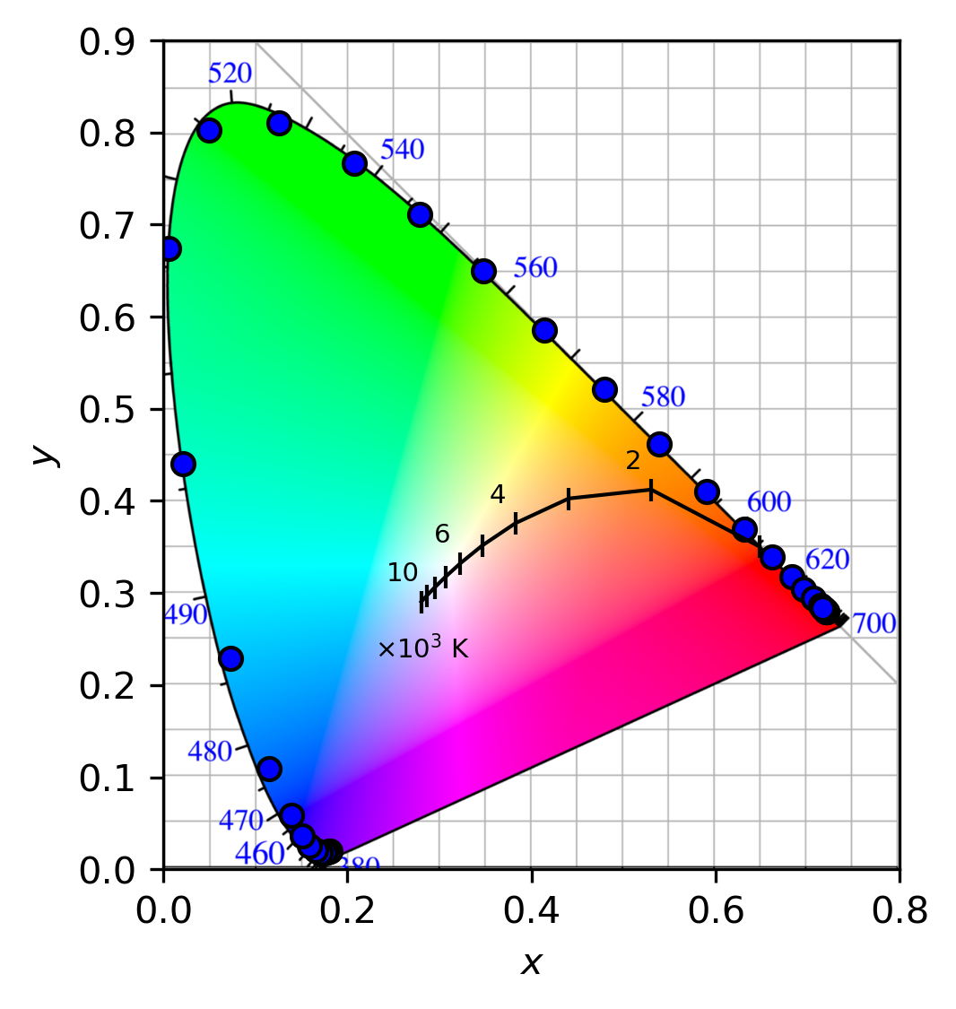
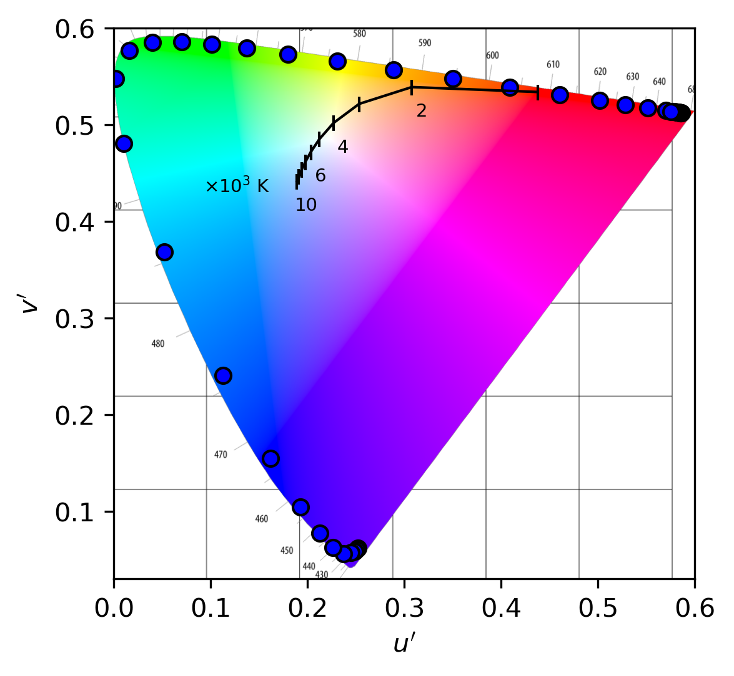
APP PHYSICS 167
COLOR IMAGING
CIE 1964 COLOR SPACES
(a)
(b)
Figure 2. CIE 1964 10 degree standard observer normalized (a) xy chromaticity coordinates and (b) u’v’ color space at different wavelengths across the visible light spectrum. The blue points demarcates the boundary of the color space and the Planckian locus representing the blackbody spectrum is plotted in black for different temperatures.
Before simulating the colors, we examine how the color spaces are made from a given tristimulus value. Following the equation presented on the previous slide, we take the spectral distribution to be a Dirac delta that spikes at a certain wavelength within the visible range and multiplied it with the color matching functions described by the CIE 1964 data. Discretizing the obtained values yields a normalized chromaticity coordinate in xy, which was then translated into u’v’ space through a relation.

Slide 5
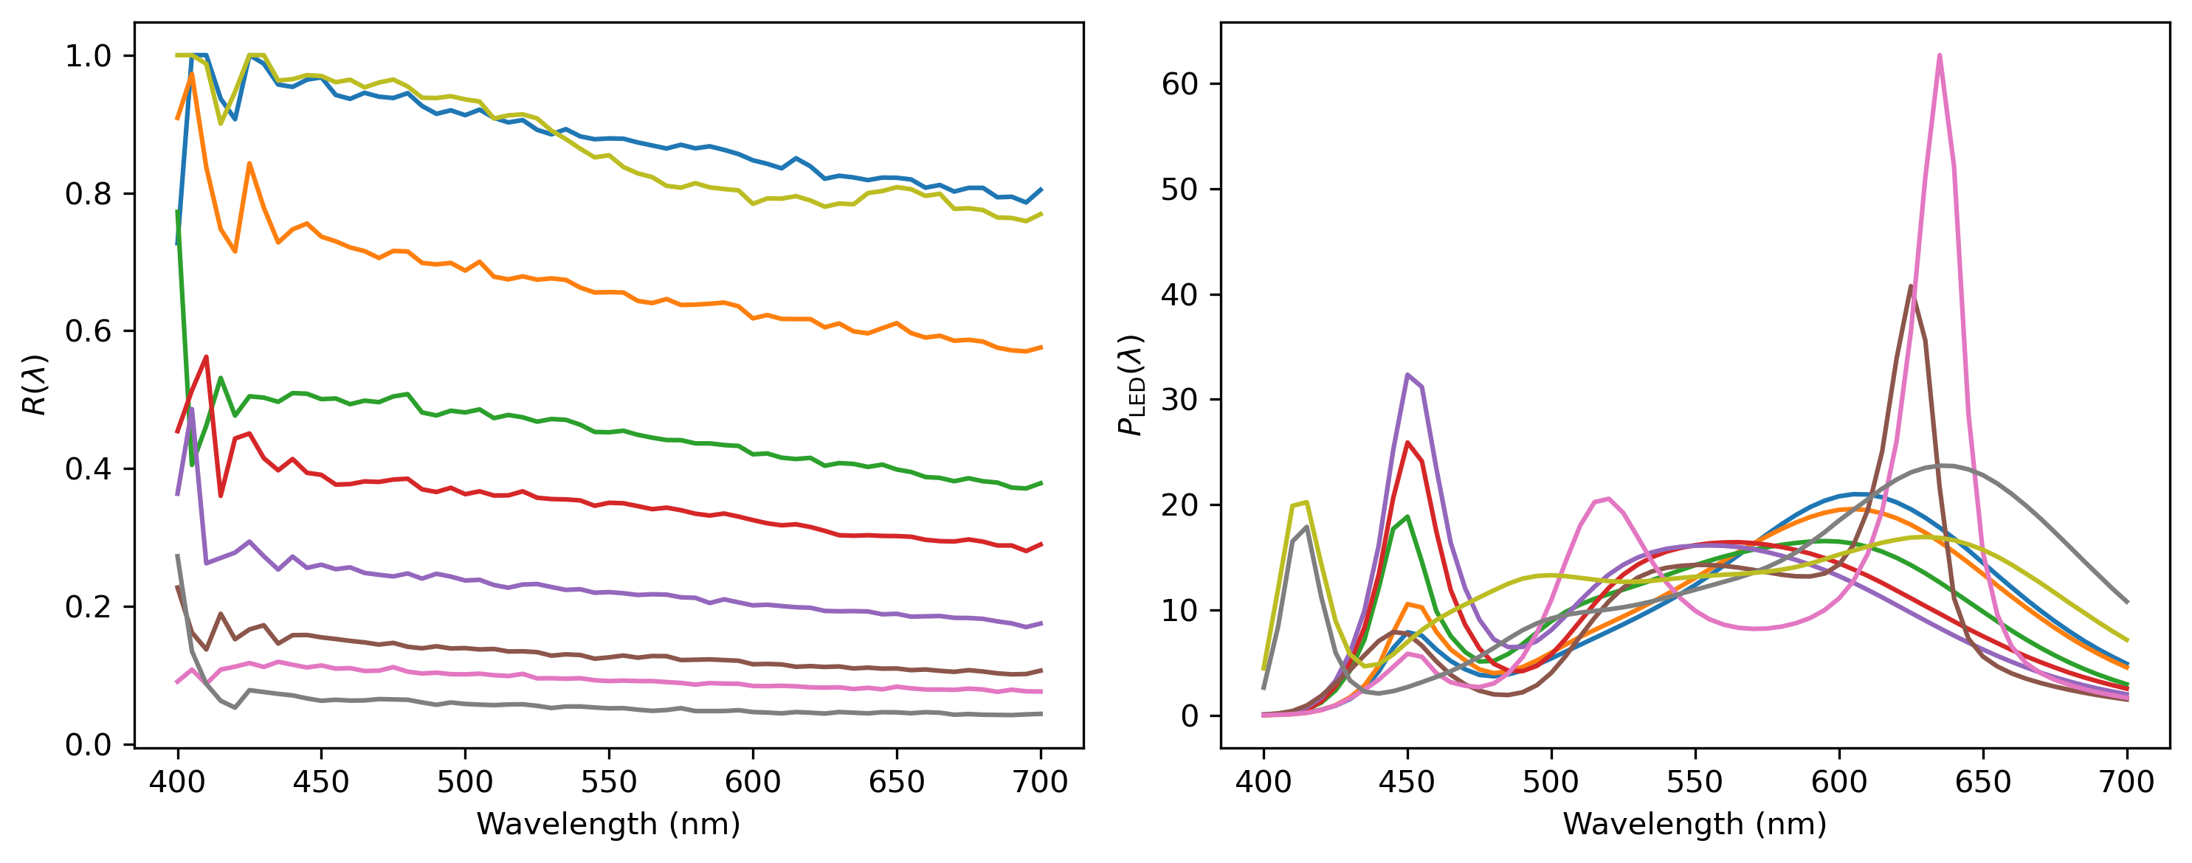
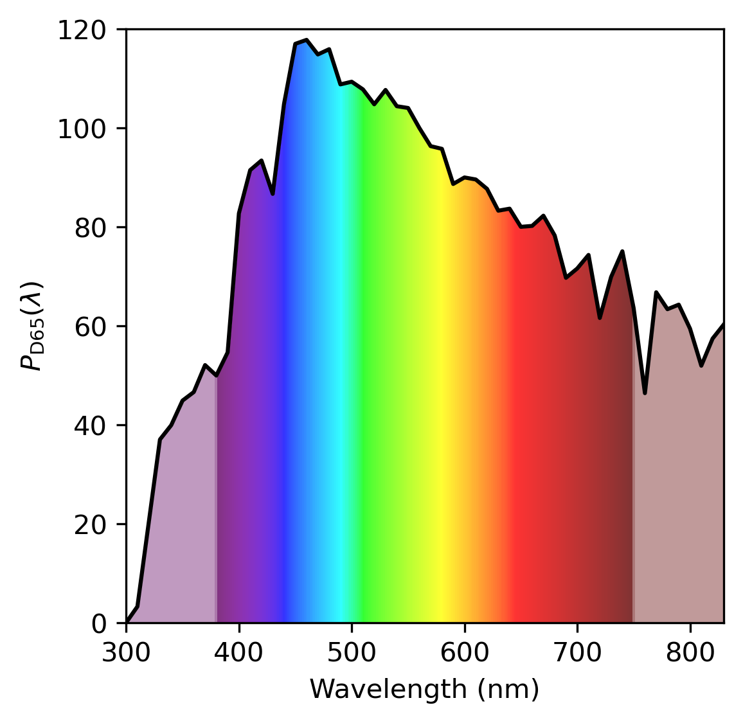
APP PHYSICS 167
COLOR IMAGING
MUNSELL CHIPS
Figure 3. Reflectance of randomly chosen set of Munsell chips and spectral power distributions of common LED illuminants and CIE D65 illuminant. Dataset for the mentioned illuminants were obtained from the database of CIE.
We considered the Munsell chips as our reflectance set of values with White LED and D65 as our illuminants. Under the perception of a standard human observer from the CIE 1964 color matching functions, we interpolated the dataset from the wavelength range of 400 nm to 700 nm of steps 5 nm for faster calculations. Following the formula on rendering the digital number, the RGB value of some chosen Munsell chips were visualized and compared how color changes under different light sources. It is worth noting that the D65 peaks at shorter wavelengths, which could affect the color rendition of the chips.

Slide 6
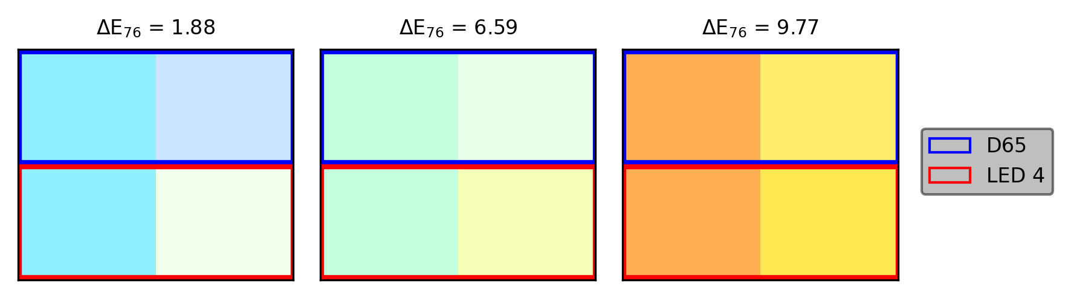
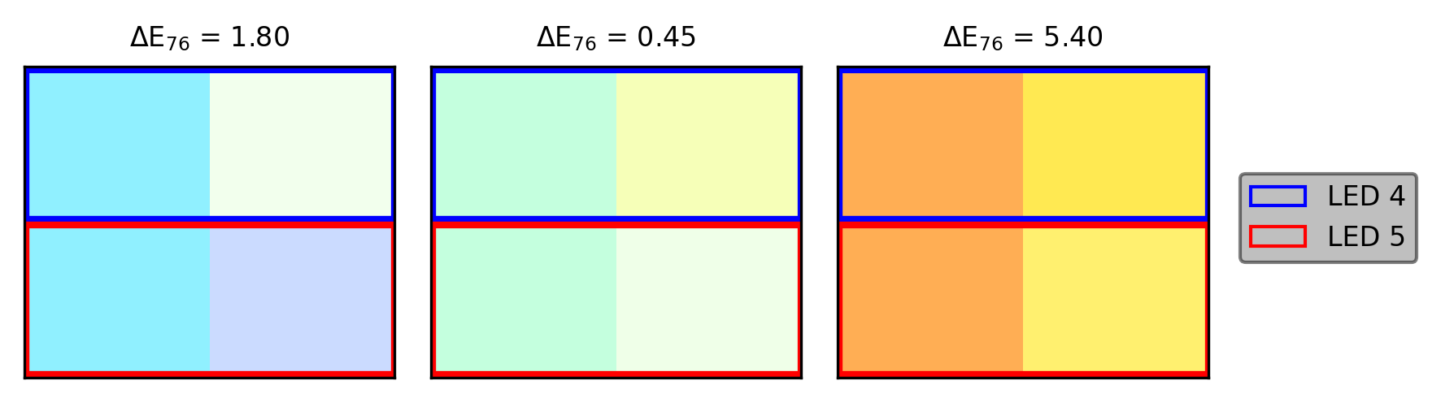
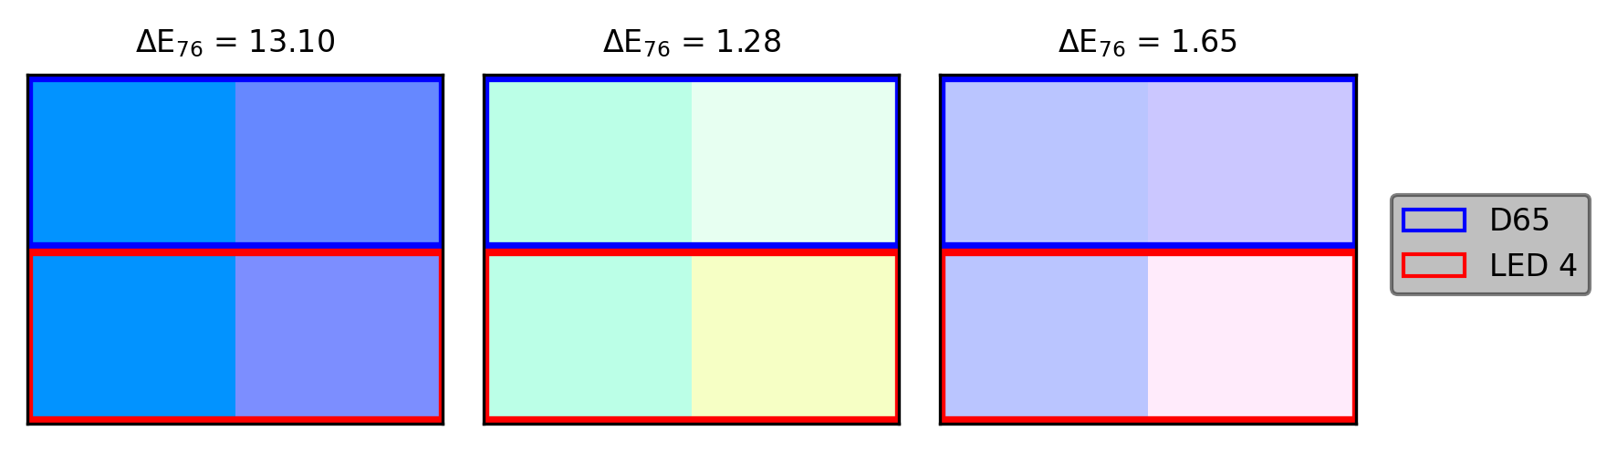
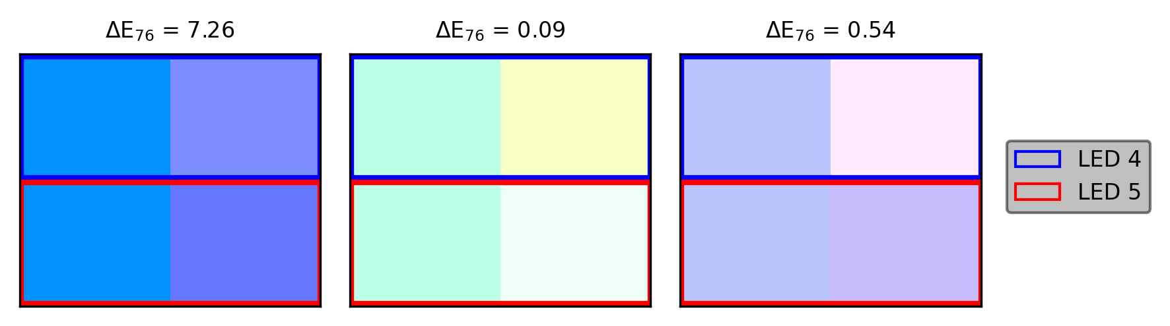
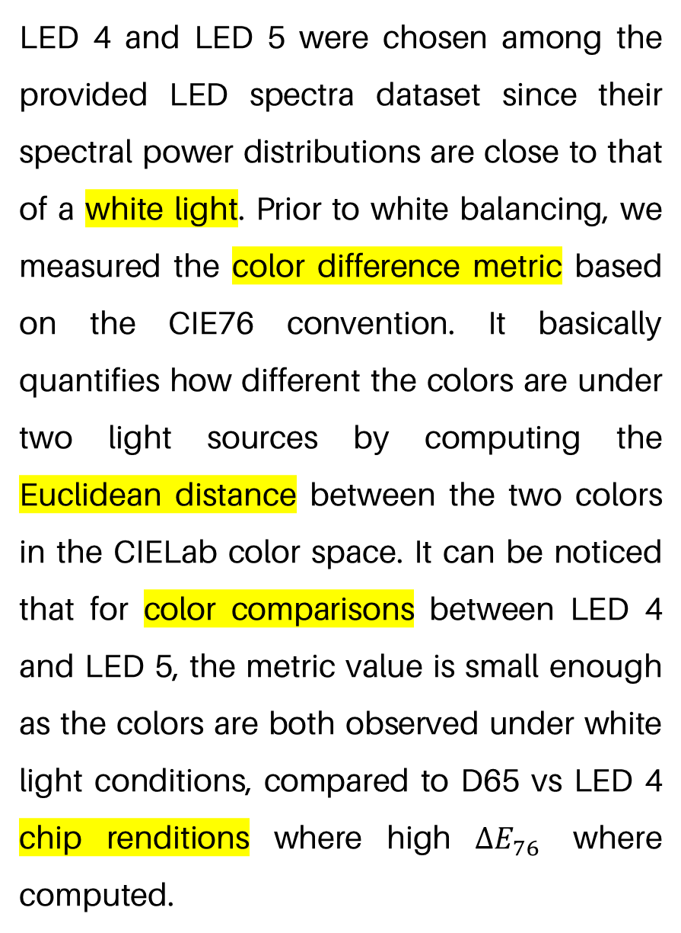
APP PHYSICS 167
COLOR IMAGING
MUNSELL CHIPS
LED 4 and LED 5 were chosen among the provided LED spectra dataset since their spectral power distributions are close to that of a white light. Prior to white balancing, we measured the color difference metric based on the CIE76 convention. It basically quantifies how different the colors are under two light sources by computing the Euclidean distance between the two colors in the CIELab color space. It can be noticed that for color comparisons between LED 4 and LED 5, the metric value is small enough as the colors are both observed under white light conditions, compared to D65 vs LED 4 chip renditions where high $ΔE_{76}$ where computed.
Figure 4. Color simulations of some Munsell chips under different light sources.

Slide 7
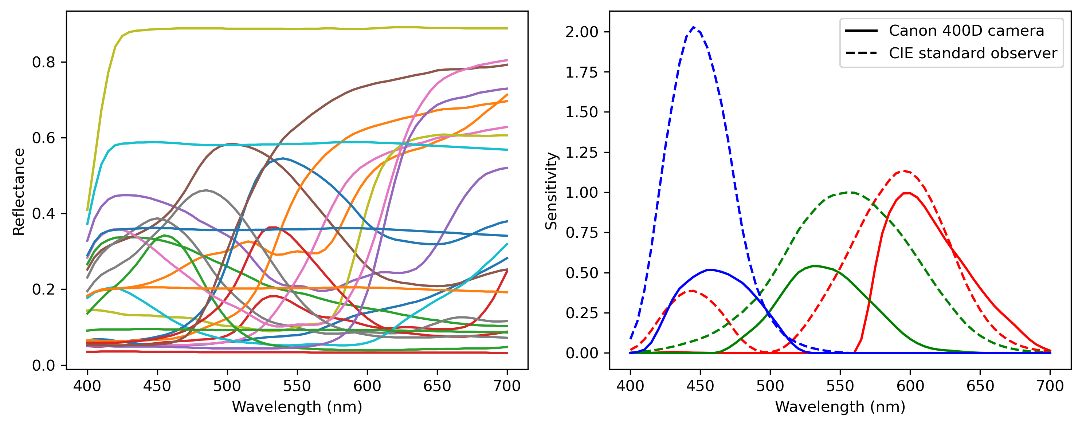
APP PHYSICS 167
COLOR IMAGING
MACBETH COLOR CHART
Figure 3. Reflectance of different Macbeth color patches and the sensitivity values of a Canon 400D camera in comparison to the standard human observer color matching functions at different wavelengths.
Similar to the Munsell chips, we also examined the colors on the Macbeth patches under a D65 illuminant, but on the regime of a Canon 400D sensitivity in contrast to the standard human observer (CIE 1964 10º). Data interpolation was also carried to match the wavelengths set similar on the Munsell calculations. Following the principle of trinity of color, we discretize the products of these spectral parameters to render the RGB color of every patch under different camera sensor sensitivities.

Slide 8
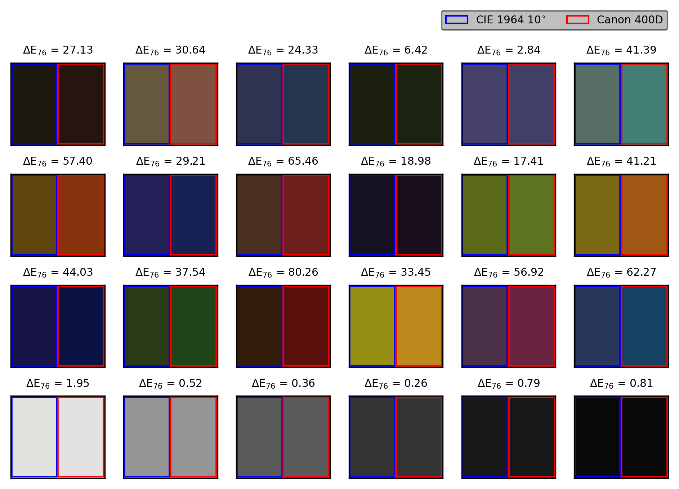
APP PHYSICS 167
COLOR IMAGING
Figure 4. Replicated Macbeth color chart renditions under a Canon 400D camera sensor in comparison with the CIE 1964 10º sensitivities.

Slide 9

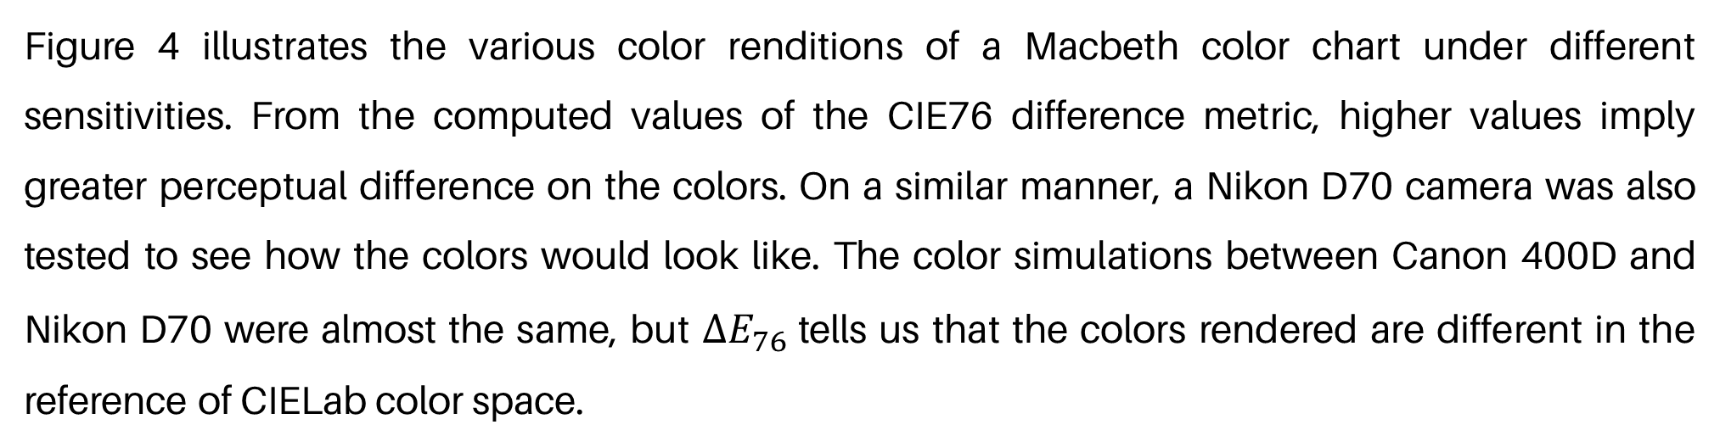
APP PHYSICS 167
COLOR IMAGING
RENDERED COLOR ANALYSIS
Figure 5. Two Macbeth patches for comparison in terms of their color difference metric in the color renditions.
Figure 4 illustrates the various color renditions of a Macbeth color chart under different sensitivities. From the computed values of the CIE76 difference metric, higher values imply greater perceptual difference on the colors. On a similar manner, a Nikon D70 camera was also tested to see how the colors would look like. The color simulations between Canon 400D and Nikon D70 were almost the same, but $ΔE_{76}$tells us that the colors rendered are different in the reference of CIELab color space.

Slide 10
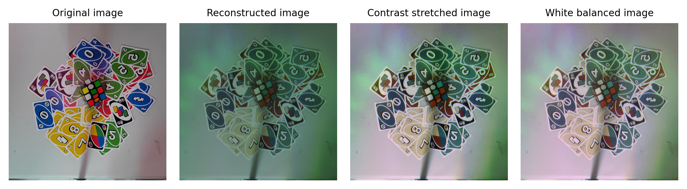
APP PHYSICS 167
COLOR IMAGING
RGB IMAGE RECONSTRUCTIONS
Figure 6. Image reconstructions of an RGB image and its white balanced counterpart.
The last part of the activity sought to reconstruct an RGB image from a single channel matrix. The reconstruction was achieved by taking a picture of the scene under red, green, and blue cellophanes in grayscale. The reconstructed image was carried out by stacking the three image matrices together. It can be observed that the reconstructed image and white balanced image were pale in color in contrast to the original one. This could be possibly attributed to the glares in the cellophanes upon capture, affecting the pixel values at some regions of the image. Nonetheless, the color rendered were still on close comparison with the original one with the background pixels appearing to be a bit dark yellow upon reconstruction.

Slide 11
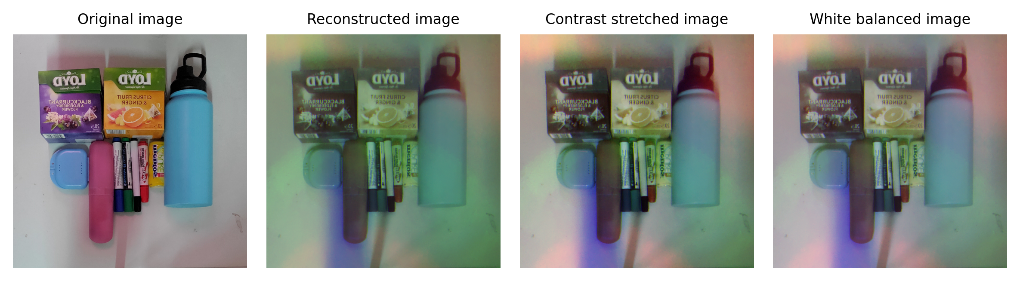
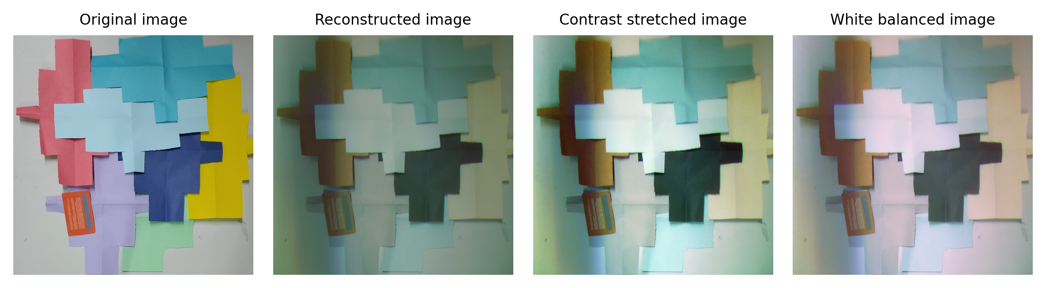
APP PHYSICS 167
COLOR IMAGING
MORE SAMPLE IMAGES

Slide 12
APP PHYSICS 167
COLOR IMAGING
REFLECTION
I find the activity fun since I was able to visualize different color rendition at a given spectral condition and parameter. The color metric difference were really helpful in distinguishing the colors that appear to be perceptually identical to each other. I will give myself a grade of 100 / 100 for accomplishing the objectives of the activity and addressing the nuances of the codes and color simulations in general.
REFERENCES | GITHUB
M. Soriano, Applied Physics 167 – Trichromaticity of color mixture.
M. Soriano, Applied Physics 167 – Color order and difference specification.
M. Soriano, Applied Physics 167 – Color image capture and rendering.
https://cie.co.at/datatable/cie-1964-colour-matching-functions-10-degree-observer
https://cie.co.at/datatable/cie-standard-illuminant-d65
https://cie.co.at/datatable/relative-spectral-power-distributions-illuminants-representing-typical-led-lamps-1nm
https://nae-lab.org/~rei/research/cs/zhao/database.html

